Slide 1
Elliptic Curve
Mohamed Reda

Slide 2
Content
What is Elliptic Curve?
History of Elliptic Curve.
Why Elliptic Curve Cryptography?
Abelian Groups
Elliptic Curves over Real Numbers
Geometric Description of Addition
Algebraic Description of Addition
Elliptic Curve Diffie-Hellman (ECDH)

Slide 3
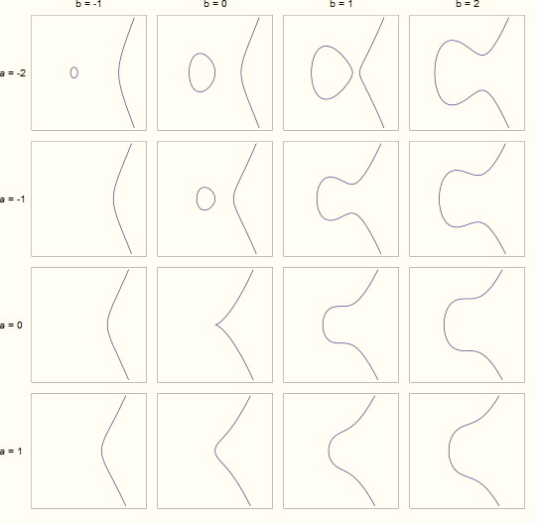
What is Elliptic Curve?
An elliptic curve is a curve of the form
y² = x³ + ax + b
where 4a³ + 27b² ≠ 0
Plus a point O at “infinity”. It is at the end
of all vertical lines.
If 4a³ + 27b² = 0, then we have a singular elliptic curve
a singular elliptic curve lead to having to not having 3 distinct roots

Slide 4

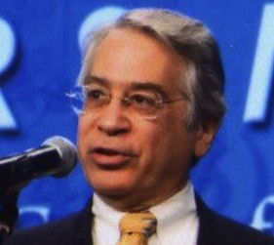
History of Elliptic Curve
Elliptic curves as algebraic/geometric entities have been studied extensively for the past 150 years, and from these studies has emerged a rich and deep theory. Elliptic curve systems as applied to cryptography were first proposed in 1985 independently by Neal Koblitz from the University of Washington, and Victor Miller, who was then at IBM, Yorktown Heights.

Slide 5
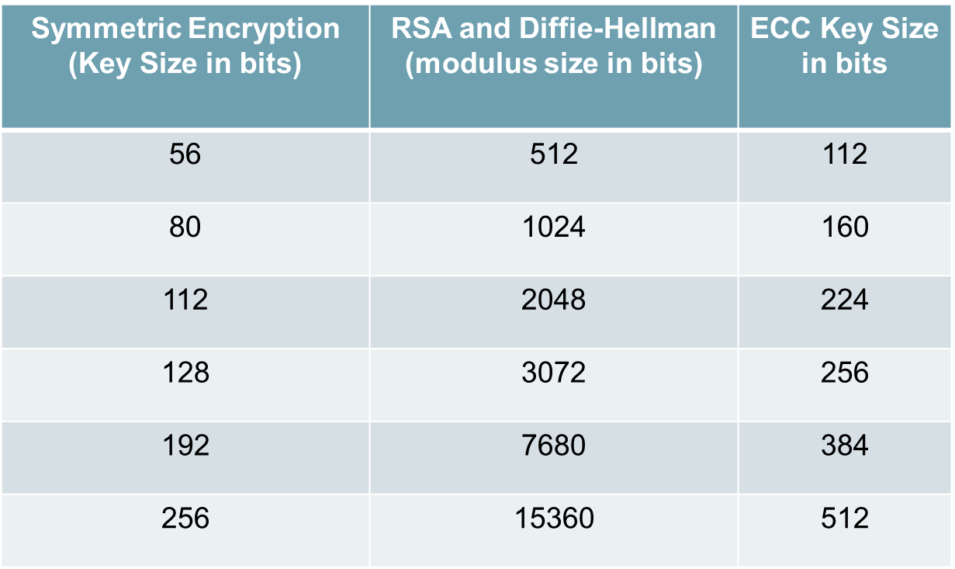
Why Elliptic Curve Cryptography?
Shorter Key Length
Lesser Computational Complexity
Low Power Requirement
More Secure

Slide 6
What is an Abelian Group
Suppose we have any binary operation, such as addition (+), that is defined for every element in a set G, which is denoted (G, +)
Then G is a group with respect to addition if the following conditions hold:
G is closed under addition: x ∈ G, y ∈ G,
imply x + y ∈ G
+ is associative. For all x, y, z, ∈ G,
x + (y + z) = (x + y) + z
G has an identity element e. There is an e in G such that x + e = e + x = x for all x ∈ G.
G contains inverses. For each x ∈ G, there exists y ∈ G, such that x + y = y + x = e.
+ is commutative. For all x ∈ G, y ∈ G, x + y = y + x.

Slide 7
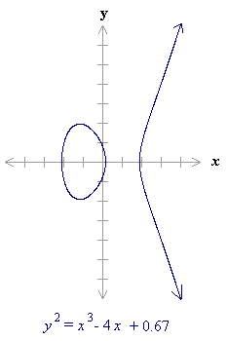
Elliptic Curves over Real Numbers
An elliptic curve over real numbers may be defined as the set of points (x,y) which satisfy an elliptic curve equation of the form:
y² = x³ + ax + b,
where x, y, a and b are real numbers.
Each choice of the numbers a and b yields a different elliptic curve.
For example, a = -4 and b = 0.67 gives the elliptic curve with equation
y² = x³ - 4x + 0.67;

Slide 8
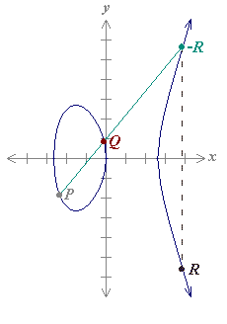
Geometric Description of Addition
Elliptic curve groups are additive groups; that is, their basic function is addition. The addition of two points in an elliptic curve is defined geometrically.
The negative of a point P = (xP,yP) is its reflection in the x-axis: the point -P is (xP,-yP). Notice that for each point P on an elliptic curve, the point -P is also on the curve.
Suppose that P and Q are two distinct points on an elliptic curve, and the P is not -Q. To add the points P and Q, a line is drawn through the two points. This line will intersect the elliptic curve in exactly one more point, call -R. The point -R is reflected in the x-axis to the point R. The law for addition in an elliptic curve group is P + Q = R.

Slide 9
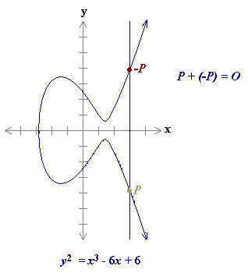
Geometric Description of Addition
The line through P and -P is a vertical line which does not intersect the elliptic curve at a third point; thus the points P and -P cannot be added as previously. It is for this reason that the elliptic curve group includes the point at infinity O. By definition, P + (-P) = O. As a result of this equation, P + O = P in the elliptic curve group . O is called the additive identity of the elliptic curve group; all elliptic curves have an additive identity.

Slide 10
Algebraic Description of Addition
When P = (xP,yP) and Q = (xQ,yQ) are not negative of each other, P + Q = R where s = (yP - yQ) / (xP - xQ) xR = s2 - xP - xQ and yR = -yP + s(xP - xR)

Slide 11
Elliptic Curve Diffie-Hellman (ECDH)
Elliptic curve variant of the key exchange Diffie-Hellman protocol.
Decide on domain parameters and come up with a Public/Private key pair
To obtain the private key, the attacker needs to solve the discrete log problem

Slide 12
How the key exchange takes place
1. Alice and Bob publicly agree on an elliptic curve E over a large finite field F and a point P on that curve.
2. Alice and Bob each privately choose large random integers, denoted a and b
3. Using elliptic curve point-addition, Alice computes aP on E and sends it to Bob. Bob computes bP on E and sends it to Alice.
4. Both Alice and Bob can now compute the point abP Alice by multiplying the received value of bP by her secret number a and Bob vice-versa.
5. Alice and Bob agree that the x coordinate of this point will be their shared secret value.

Slide 13
Pros of ECC Encryption
Shorter Key Length
Same level of security as RSA achieved at a much shorter key length
Better Security
Secure because of the ECDLP
Higher security per key-bit than RSA
Higher Performance
Shorter key-length ensures lesser power requirement – suitable in wireless sensor applications and low power devices
More computation per bit but overall lesser computational expense or complexity due to lesser number of key bits

Slide 14
Cons of ECC Encryption
Relatively newer field
Idea prevails that all the aspects of the topic may not have been explored yet – possibly unknown vulnerabilities
Doesn’t have widespread usage
Not perfect
Attacks still exist that can solve ECC (112 bit key length has been publicly broken)
Well known attacks are the Pollard’s Rho attack (complexity O(√n) ), Pohlig’s attack, Baby Step, Giant Step etc.

